Slide 1
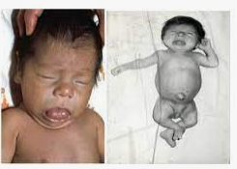
What is your diagnosis?
Would you say pathological findings?

Slide 2
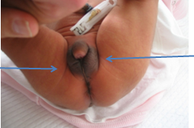
Nonpalpable gonad
Nonpalpable gonad
How do you describe this pictures?

Slide 3
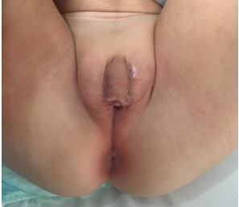
Bialteral inguinal gonad Bifid scrtoum Cordi Fallus: 3 cm Bura gösterilmesin
Please say pathological findings

Slide 4
What is the description of short stature ?
Boy sds -2 altı olanlar
Hedef boy sds -1.6 sds altında olanlar
Uzama hız sds 1 sd fazla kayıp olanlar

Slide 5
Please say the cause of gouiter?
İyot eksikiği
Otoimmun tiroid hastalığı
Noduler ve multinoduler guatr
Hipotiroidi

