Slide 1
Signs and Symptoms in Neurological Diseases
Miraç Yıldırım m.d.
Ankara UnIversIty Faculty of MedIcIne
PedIatrIc Neurology

Slide 2
Neurological Systems
Central Nervous System
  Cerebrum
  Cerebellum
  Spinal cord
Peripheral Nervous System
  Plexus
  Peripheral nerves
  Neuromuscular junction
Autonomic Nervous System
  Symphathetic nervous system
  Parasympathetic nervous system
Neuromuscular System

Slide 3
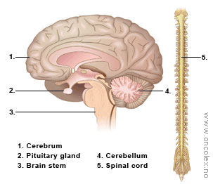
Central Nervous System
Includes cerebrum, cerebellum, basal ganglia, brainstem, spinal cord, meninges
The main functions of;
  Cerebrum: cognition (thought and memory), consciousness
  Cerebellum: balance, coordination
  Brain stem: autonomic functions (blood pressure, respiration, etc.)
  Spinal cord: interaction between the central nervous system and the peripheral nervous system

Slide 4
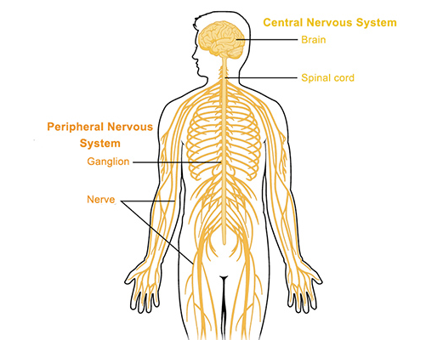
Peripheral Nervous System
Includes,
  Anterior horn cell
  Spinal nerve roots
  Plexus
  Peripheral nerves
  Neuromuscular junction

Slide 5
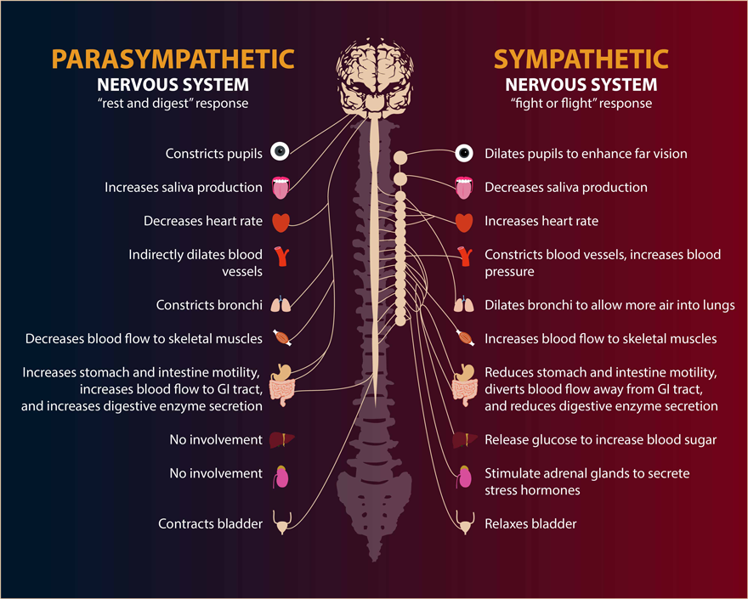
Autonomic Nervous System

Slide 6
Main Neurological Diseases
Infections
  Meningitis, encephalitis, meningo-encephalitis, etc.
Inflammatory
  Acute disseminated encephalomyelitis, multiple sclerosis, neuromyelitis optica spectrum disorders, etc.
Degenerative
  Neurometabolic disorders, motor neurone disease, etc.
Neoplastic
  Benign/malignant, primary/secondary neoplasms
Paroxysmal disease
  Epilepsy
Congenital/structural diseases

Slide 7
Neurological Diseases
Disorders of the nervous system may involve the following;
  Vascular/traumatic: stroke, transient ischemic attack (TIA), subarachnoid hemorrhage, subdural hemorrhage and hematoma, etc.
  Metabolic: neurometabolic diseases
  Infectious: meningitis, encephalitis, polio, abscess
  Functional: headache, epilepsy, dizziness
  Congenital/structural: cortical development malformations of brain, brain or spinal cord injury, Bell's palsy, carpal tunnel syndrome, brain or spinal cord tumors, peripheral neuropath
  Degenerative: neurodegenerative and genetic disorders, multiple sclerosis
  Toxic: neurological involvement of various toxic substances

Slide 8
Common Signs and Symptoms
Persistent or sudden onset of a headache
Nausea and vomiting
Weakness or loss of muscle strength
Memory problems
Gait problems
Abnormal movements
Loss of sight or double vision (diplopia)
Impaired mental ability
Lack of coordination
Mood disturbance
Sensory disturbance
Confusion
Convulsion/seizure
Special senses: speech, vision, swallowing, hearing, smell
Sphincter dysfunction
Muscle rigidity
Micro- or macrocephaly

Slide 9
History in Neurological Diseases
Age
Gender
Family history
Past medical history
  Vaccinations, infections, underlying diseases, travel
Onset of symptoms, duration of symptoms, associated symptoms
Medications

Slide 10
Extraneurological Signs and Symptoms in Neurological Diseases
Cutaneous-hair abnormalities
  Hypo- or hyperpigmented lesions, axillary or inguinal freckling, facial port-wine hemangioma, Blaschko's lines, telangiectasia, petechial and purpuric rash, pili torti (kinky hair), etc.
Ophthalmological findings
  Papilledema, optic atrophy, ptosis, coloboma, ophthalmoplegia, glaucoma, microphthalmia, cataract, Lisch nodules of the iris (hamartomas)
Cardiac involvement
  Cardiac arrhythmias, cardiomyopathy, rhabdomyoma, congenital heart defects
Abdominal involvement
  Hepatosplenomegaly, gastrointestinal motility disorders, omphalocele
Dysmorphic features
  Head, eyes, ears, nose, mouth, extremities, etc.
Skeletal findings
  Rhizomelia, clinodactyly, syndactyly, scoliosis, sacral dimple, myelomeningocele etc.
Rheumatological findings
Metabolic findings

Slide 11
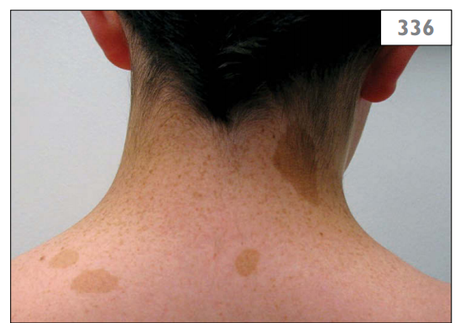
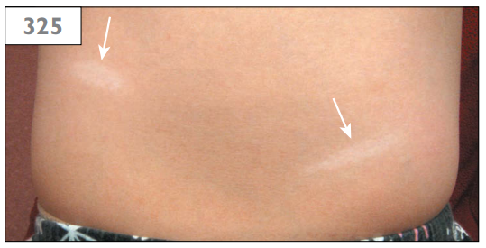
Neurocutaneous Abnormalities
hypopigmented lesions
Café-au-lait skin lesions

Slide 12
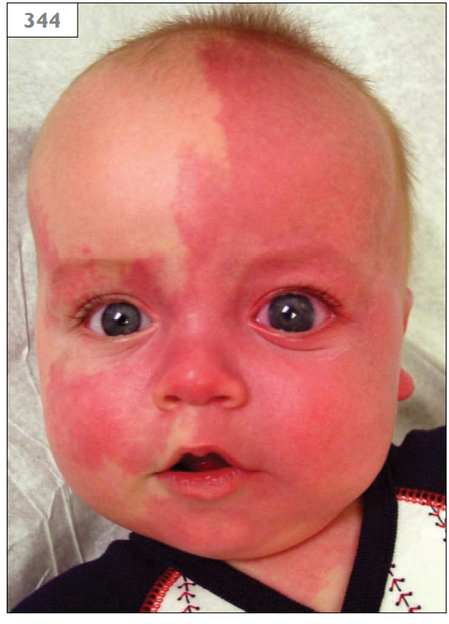
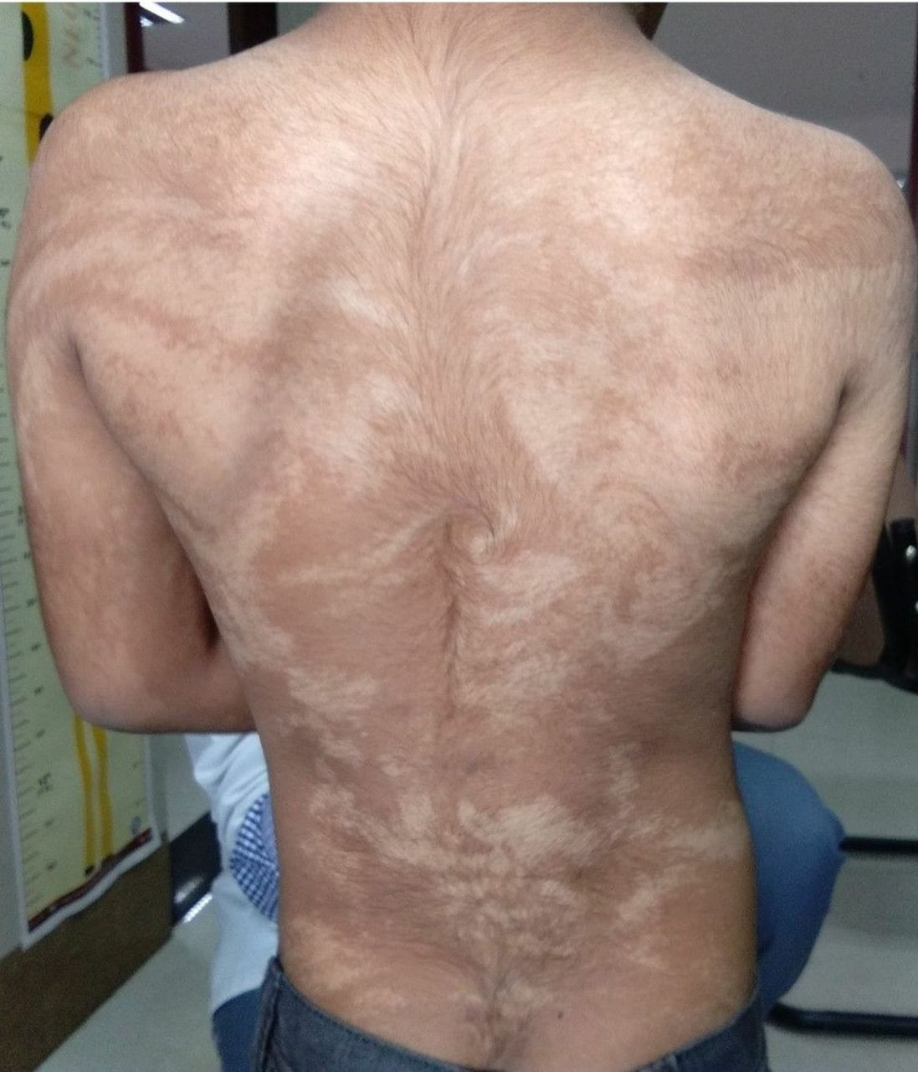
Neurocutaneous Abnormalities
port-wine stain (facial hemangioma)
Blaschko’s lInes

Slide 13
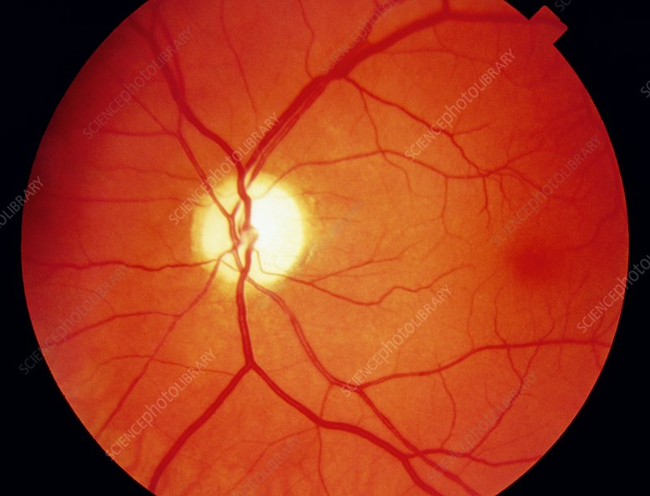
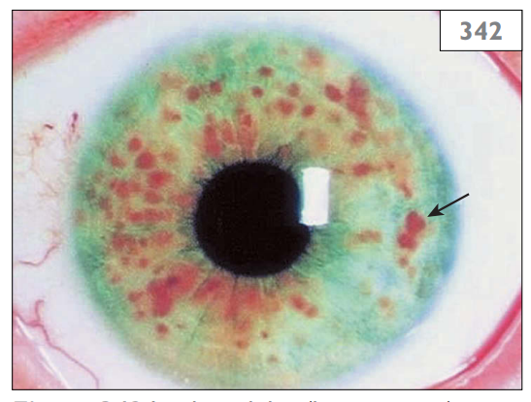
Ophthalmological Findings
OptIc atrophy
Lisch nodules of the iris (hamartomas)

Slide 14
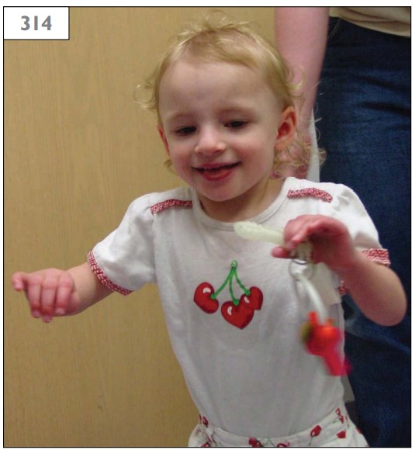
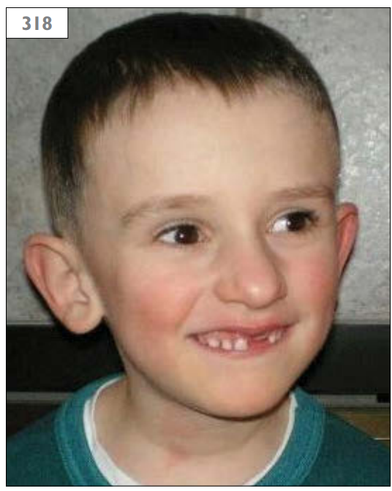
Dysmorphic features
Angelman syndrome
(Happy disposition and stereotypic arm posture)
fragile X syndrome
(Typical facial appearance and prominent ears)

Slide 15
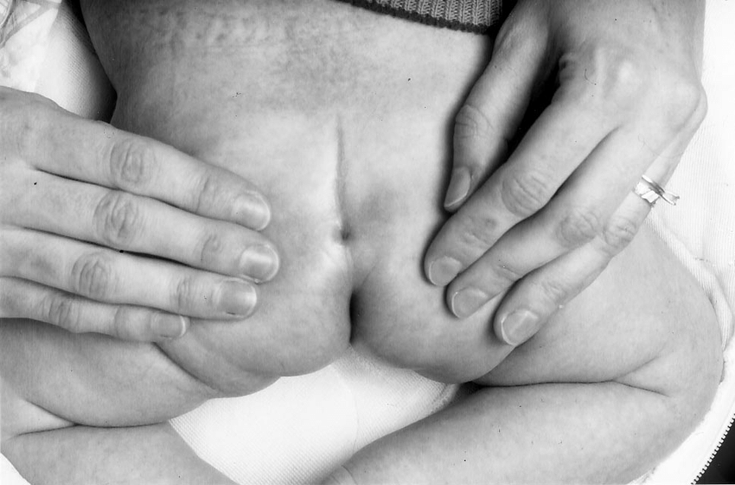
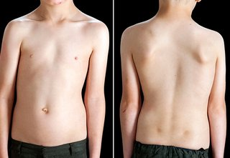
Skeletal Findings
Scolıosıs
Sacral dımple

Slide 16
Motor Neuron Diseases
Upper Motor Neuron Diseases
  Muscle weakness
  Decreased control of active movement
  Spasticity
  Extansor plantar response (positive Babinski sign)
  Increased deep tendon reflex with/without clonus
  No fasciculation
  Pronator drift
Lower Motor Neuron Diseases
  Muscle paresis or paralysis
  Weakness (limited to segmental or focal pattern)
  Hypotonia or atonia
  Flexor plantar response (negative Babinski sign)
  Hyporeflexia (decreased deep tendon reflex)
  Fasciculations
  Fibrillations

Slide 17
Central Nervous System Disorders
Headache
Changes in consciousness
Inability to concentrate
Loss of feeling
Memory loss
Loss of muscle strength
Tremors
Seizures
Increased tendon reflexes
Spasticity
Involuntary movements
Paralysis
Slurred speech
Visual disturbances
Pins-and-needles sensation

Slide 18
Altered States of Consciousness
Confusion: misperception of sensory phenomena often associated with periods of hyperexcitability and irritability alternating with drowsiness.
Delirium: marked confusion with visual hallucinations and agitation.
Somnolence: mild decrease in alertness, arousal to voice or light tactile stimulation.
Lethargy: moderate decrease in alertness, decreased attention span, arousal to voice stimulation with some verbal response.
Stupor: patient requires vigorous and repeated stimuli to arouse then returns to unresponsiveness; there may be some purposeful motor response to noxious stimuli.
Coma: unarousable, no vocalization, no purposeful movements.

Slide 19
Headache
The most common condition in neurological diseases
Numerous etiologies
  May be a symptom of extraneurological diseases
Acute/chronic
Associated with irritation or inflammation of any pain sensitive structures in head
Pain-sensitive structures in the head
  Intracranial: Venous sinuses and large veins in the duramater, duramater covering the base of the skull (tentorium cerebelli, falx cerebri), large arteries and meningeal arteries
  Extracranial: Veins and arteries, muscles, mucosal and periosteal structures, eyes, skin and subcutaneous tissues
Pain may be constant, pressure, throbbing, stabbing, or intermittent

Slide 20
Headache-Red Flags
Sudden-onset headache
Associated with seizures, unexplained behavior changes, or decline in school achievement
Focal neurologic signs or symptoms
Exertion-triggered headaches starting during exercise, coughing, or Valsalva maneuver
Presence of worsening pattern, important changes in the quality of pain, its location, and frequency of headaches
Prominent vomiting
Sleep disruption by headache

Slide 21
Migraine Headache
Recurrent, severe or moderate headache
More common post-adolescent in females, pre-adolescent in males
Common onset in adolescence
1-72 hours duration
Uni- or bilateral, throbbing headache, nausea, vomitting, dizziness
Visual disturbances
With or without aura
Etiology: vasoactive chemicals, vasodilation, serotonin, neuropeptide y

Slide 22
Paroxysmal events
Non-epileptic paroxysmal events
seızures
Gastroesophageal reflux (Sandifer syndrome)
Breathholding spells
Self-stimulatory behavior (masturbation)
Migraine variants (paroxysmal torticollis or paroxysmal vertigo)
Shuddering attacks
Daydreaming
Stereotypies
Psychogenic nonepileptic seizures
Movement disorders (paroxysmal dyskinesias)
Febrile seizures
Idiopathic generalized epilepsy
Infantile spasms
Panayiotopoulos syndrome
Childhood absence epilepsy
Rolandic epilepsy
Idiopathic childhood occipital epilepsy (Gastaut type)
Juvenile myoclonic epilepsy

Slide 23
Cerebral Palsy
Oro-motor dysfunction
Difficulty in feeding and drooling
Early period of hypotonia
Feeding, speech and language problems
Delayed motor milestones
Incoordination of movements
Limited synchronized movements
Impaired sensory and cognitive functions
Spasticity
Hypertonia
Increased deep tendon reflexes
Crossed adductor reflex
Extensor plantar response (Babinski sign)
Dyskinesia (involuntary movements)
Abnormal regulation of tone
Abnormal postural control
Coordination deficits

Slide 24
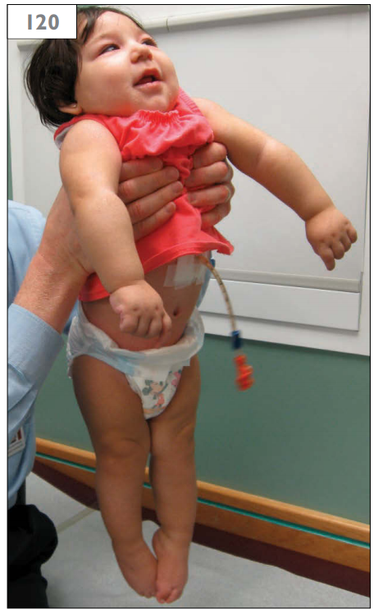
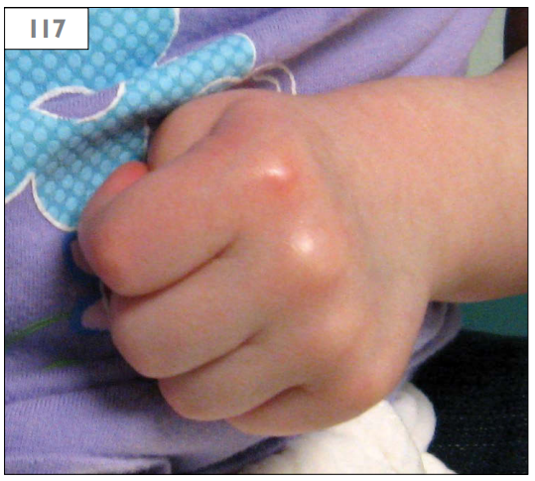
Cerebral Palsy
spastic quadriparesis (scıssorıng)
Cortical thumb (cortical fisting)

Slide 25
Increased Intracranial Pressure
Headache
Nausea and vomiting
Visual symptoms
  Blurred vision
  Diplopia
  Photophobia
Neck stiffness
Failure to thrive
Shrill cry
Split sutures
Head tilt
Irritability
Retroorbital pain
Dizziness
Incontinence
Changes in higher cognitive function
Preferring a knee-chest position
Papilledema
Bulging fontanel on palpation
Cushing response
  Hypertension
  Bradycardia
  Irregular breathing
Sixth cranial nerve palsy

Slide 26
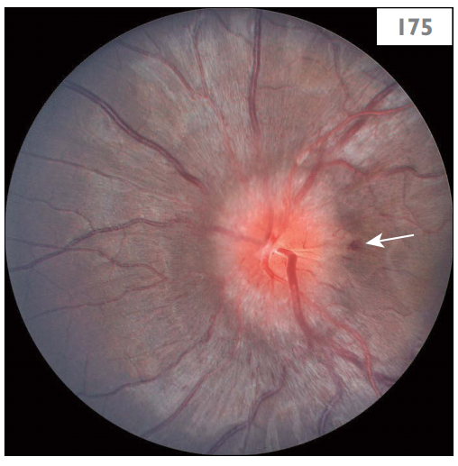
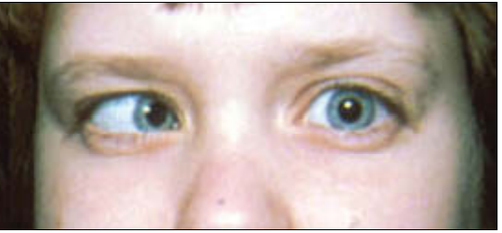
Increased Intracranial Pressure
Papilledema and retinal hemorrhage
abducens nerve palsy

Slide 27
Meningitis (Meningeal Irritation)
Fever
Irritability
Bulging fontanelle
Headache
Vomiting
Lethargy
Seizures
Alteration of consciousness
Apnea, hypothermia, jaundice, anorexia (especially in newborn)
Nuchal stiffness
  Observing the range of neck flexion by raising the head passively in the supine position.
Kernig sign
  Passively raising a lower limb with the knee flexed in the supine position and then by extending the knee joint. (Angle of knee extension is limited or the patient complains of pain on the posterior aspect of the thigh)
Brudzinski's sign
  Forced flexion of the neck elicits a reflex flexion of the hips.

Slide 28
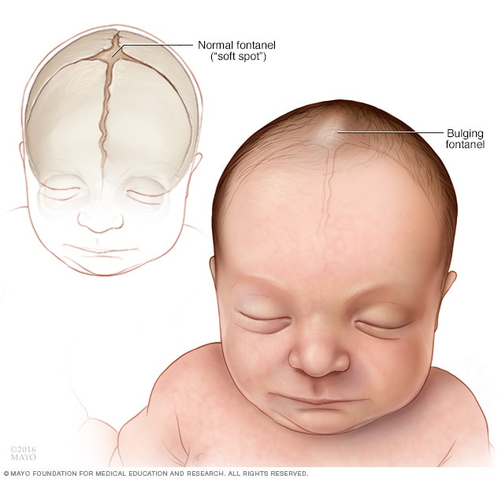
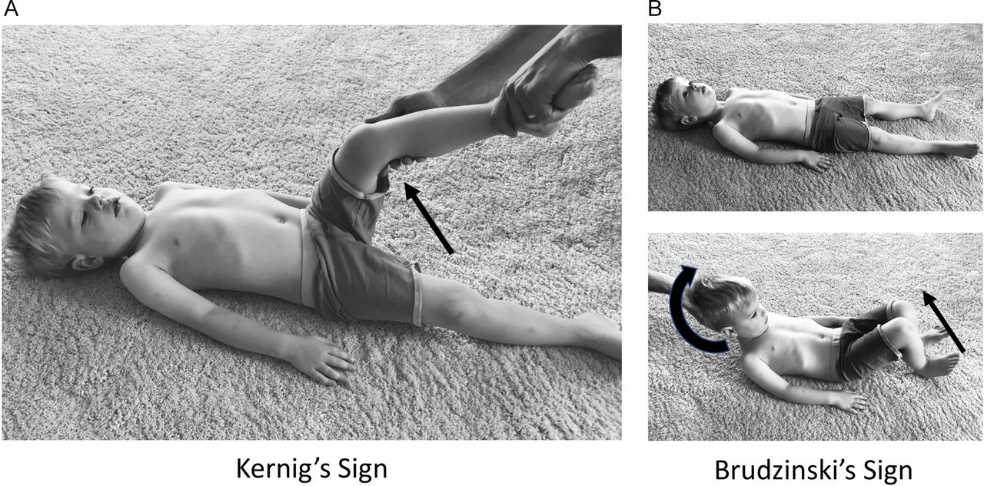
Meningitis
Bulging fontanelle
Kernıg & brudzınskı’s sıgns

Slide 29
Peripheral Nervous System Disorders
General symptoms
    Single focal lesions: weakness, numbness, and pain in one part of the limb
    Diffuse lesions: weakness, numbness, and pain in more than one limb (usually bilateral and distal)
General signs
    Lower motor neuron signs: muscle atrophy, fasciculations
    Hyporeflexia or areflexia
    Patch of sensory loss, stocking-glove sensory loss

Slide 30
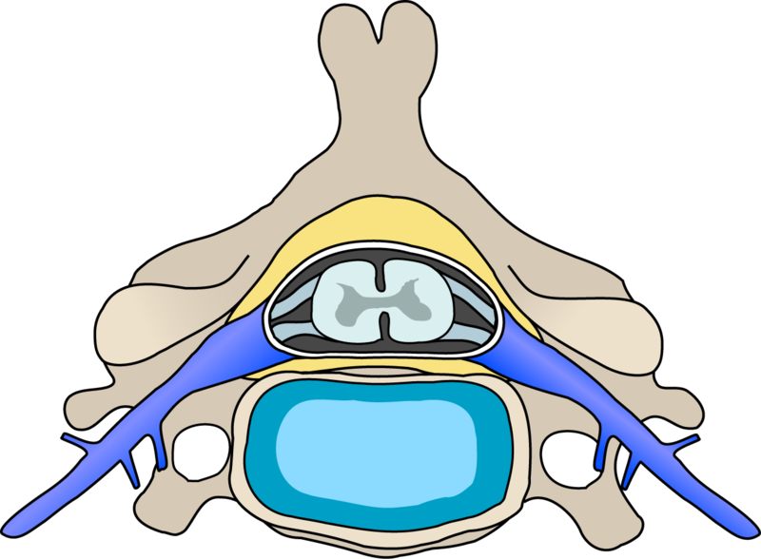
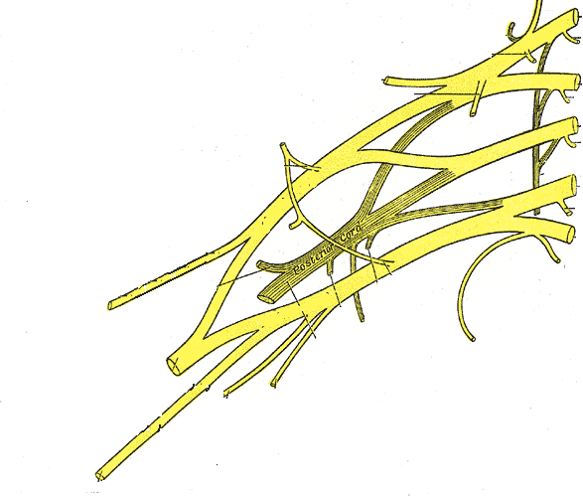
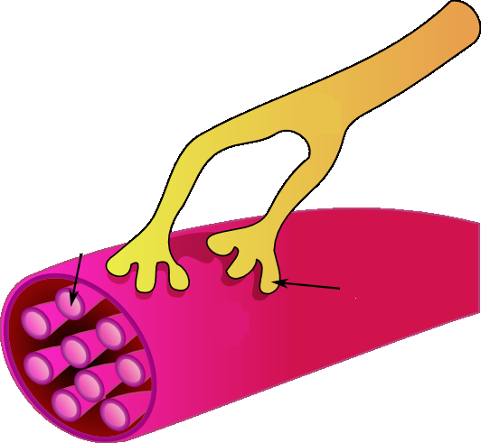
Peripheral Nervous System
Plexus
Anterior horn
cells
Spinal nerve root
Single nerve
Neuromuscular junction and muscle

Slide 31
Peripheral Nervous System Disorders
Mononeuropathy
Weakness, numbness, pain, paresthesias confined to the distribution of affected nerve.
Most common causes: trauma, prolonged limb immobility (such as surgery)
Peripheral polyneuropathy
Feet numb with paresthesia or pain
Distal weakness, atrophy
Steppage gait
Imbalance, falls
Feet injuries and deformations
Autonomic dysfunctions: orthostatic hypotension, bladder dysfunction
Most common causes: toxic, metabolic, drugs, liver and kidney diseases, infections (neurosyphilis, HIV), inflammatory diseases

Slide 32
Peripheral Nervous System Disorders
Acute Inflammatory Demyelinating Polyneuropathy (Guillain-Barré syndrome)
  Develops within 1-2 weeks
  Follows viral infections or vaccinations
  Distal weakness
  Ataxia
  Numbness
  Paresthesia
  Limb pain
  Ascending progress
  Autonomic instability
  Swallowing difficulty
  Intubation

Slide 33
Neuromuscular Diseases
Symptoms
Abnormal gait
  Steppage
  Toe walking
  Waddling
Easy fatigability
Slow motor development
Frequent falls
Specific disability
  Arm elevation
  Climbing stairs
  Hand grip
  Rising from floor
Signs
Observation
  Atrophy or pseudohypertrophy
  Fasciculations
  Functional ability
Palpation
  Muscle texture
  Tenderness
Examination
  Joint contractures
  Myotonia
  Decreased muscle strength
  Decreased tendon reflexes
  Gower sign
  Scapular winging

Slide 34
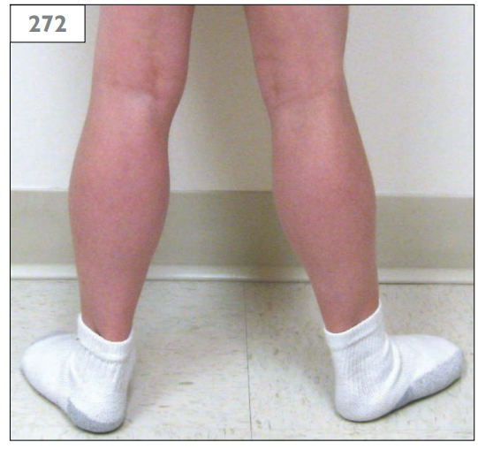
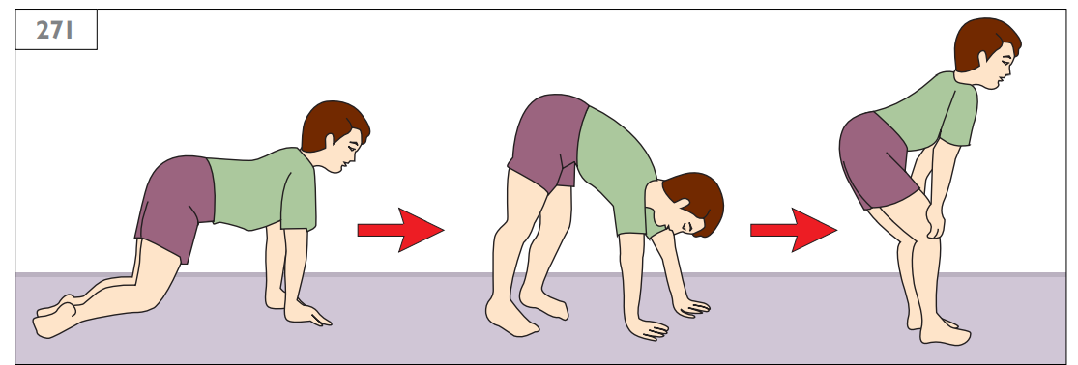
Neuromuscular Diseases
Gowers sign
pseudohypertrophy

Slide 35
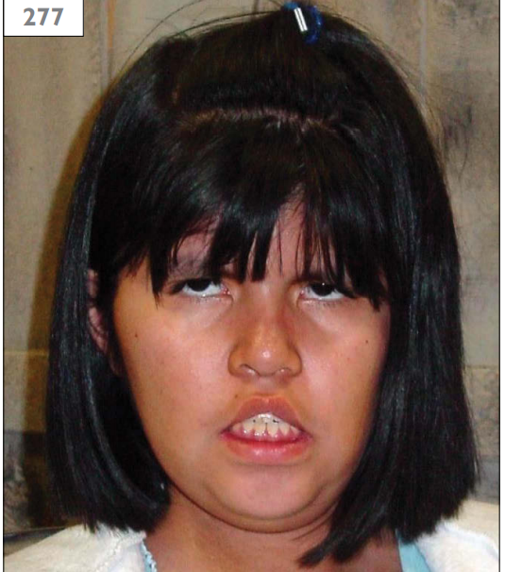
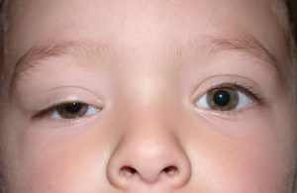
Neuromuscular Diseases
myopathic face (v-shaped upper lip)
Unilateral ptosis

Slide 36
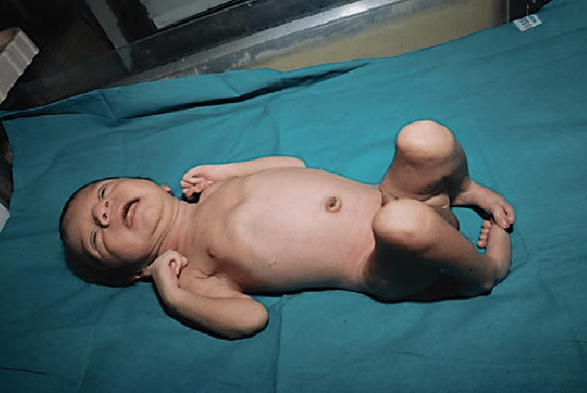
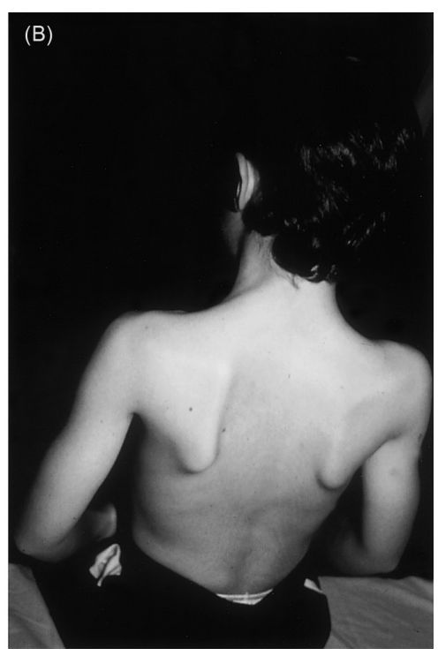
Neuromuscular Diseases
Joint contractures
scapular winging

Slide 37
Hypotonia
Clinical Signs of Central Hypotonia
Altered mental status
Seizures
Irritability
Dysmorphic features
Macrocephaly or microcephaly
Hyperreflexia
Spasticity
Exaggerated primitive reflexes
Organomegaly
Poor visual fixation
Abnormal pupillary reflexes
Corneal clouding or cataracts
Retinitis

Slide 38
Hypotonia
Clinical Signs of Peripheral Hypotonia
Normal mental status findings
Weakness with axial and extremity movements
Bulbar signs
Facial weakness
Ophthalmoplegia
Poor suck and swallow
Absent or depressed deep tendon reflexes
Feeble primitive reflexes
Muscle atrophy
Fasciculations
Bell-shaped chest, with pectus excavatum
Arthrogryposis
Congenital hip dislocation

Slide 39
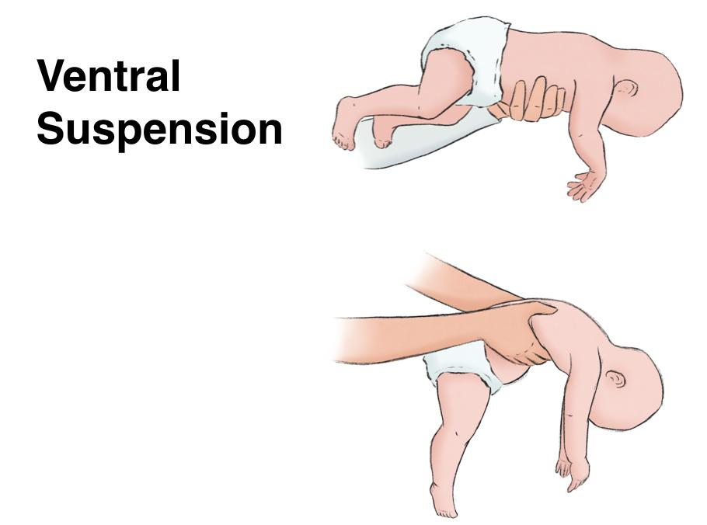
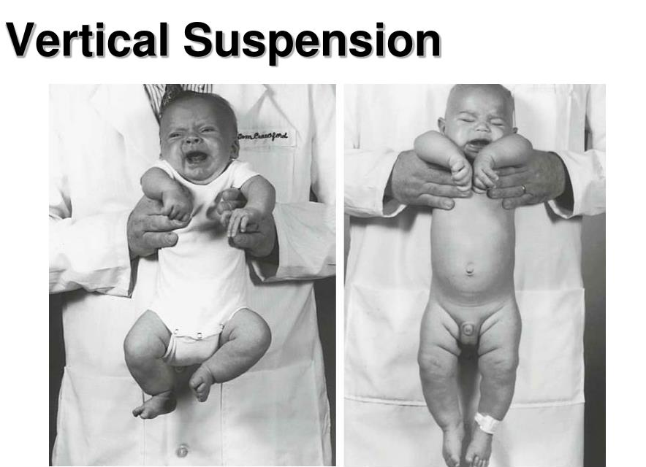
Floppy Infant
ventral suspensıon
Vertical suspensıon

Slide 40
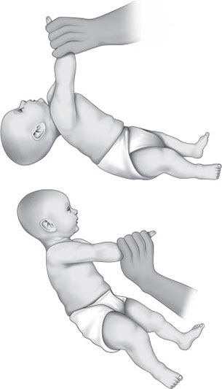
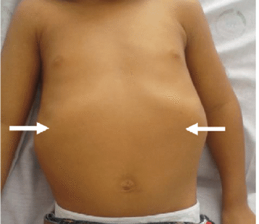
Floppy Infant
Tractıon response
Bell-shaped chest

Slide 41
Movement Disorders
Involve;
  Impaired performance of voluntary movements
  Dysfunction of posture
  The presence of abnormal involuntary movements
  The performance of normal-appearing movements at inappropriate or unintended times
Most, but not all, hyperkinetic movement disorders subside in sleep
Chorea, athetosis, primary and secondary dystonias, most tremors and all stereotypies generally disappear in sleep
Divide into two major categories;
  Hyperkinetic movement disorders
    Tics
    Stereotypies
    Chorea
    Dystonia
    Myoclonus
    Tremor
    Athetosis
  Hypokinetic movement disorders
    Parkinsonism (bradykinesia, hypokinesia or akinesia)

